Slide 1

WAREHOUSE MANAGEMENT SYSTEM

Slide 2
GROUP NUMBER- 03
TEAM MEMBERS:-
Ayush Bhat (A20383004)
Sambhav Chopda (A20376777)
Zeshan Sayed (A20379970)

Slide 3
INTRODUCTION
Warehouse management system: A software application supporting day to day operations in a warehouse.
Works synchronously with suppliers.
Application lets administrator to add new customers/new suppliers/ new stocks.
Application lets administrator to update existing customers/new suppliers/ new stocks.
Contains information about stocks in and out.
Generate reports and print them.
Perform CRUD operation on tables with data integrity and data security.
Notes:
Thus a warehouse management system is planned, managed and controlled to work synchronously with other suppliers.

Slide 4
Data integrity:
Provides integrity in retrieval, storage and processing.
Integrity obtained through relations between different tables.
Data Security:
Process of securing data from unwanted intrusions and manipulations.
Data is secured by implementing MD5 in the passwords validation system.
Password secured through security questions.

Slide 5
Implementation Features:
System performs basic CRUD operations on:
All_stock_details
Stock_customer_details
Stock_supplier_details
Stock_purchase
Stock_sales
Stock_availability
Use of CSS to increase aesthetic feel.
Use of Auto-fill.

Slide 6
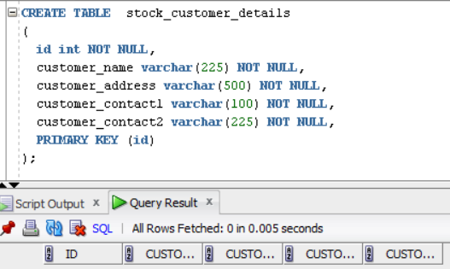
Creating table stock_customer_details:

Slide 7
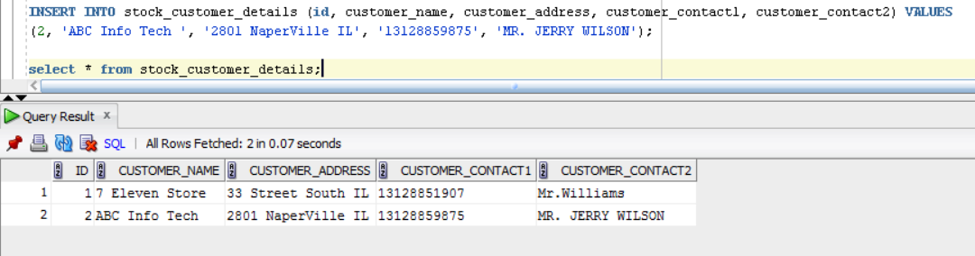
Inserting into table stock_customer_details:

Slide 8
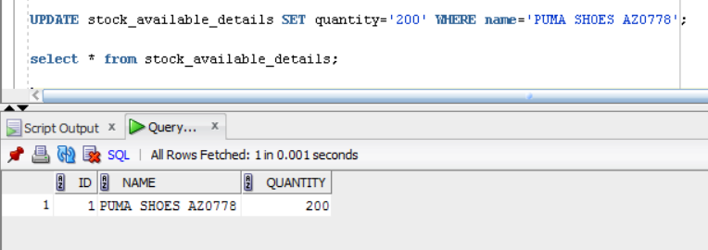
Updating table stock_available_details:

Slide 9
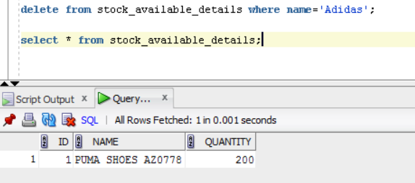
Deleting from table stock_available_details:

Slide 10
Special features
MD5
SQL injection
Pagination
Auto fill

Slide 11

MD5
An algorithm used to preserve data integrity through creation of a 128-bit message digest from data input.
E.g. $mypassword=md5($mypassword);
ORIGINAL PASSWORD: “admina”
MD5 IMPLEMENTATION: “91183e1cb4e46961f86a2ef6287927ad”
Highly secured and difficult to decode.

Slide 12
SQL INJECTION(tried to implement)
SQL injection: A code injection technique, used to attack data-driven applications, in which nefarious SQL statements are inserted into an entry field for execution
$myusername = stripslashes($myusername);
$mypassword = stripslashes($mypassword);
STRIPSLASHES: Technique used to prevent SQL injection.
Will create an alert to the admin in case of intrusion.
$myusername = mysqli_real_escape_string($db->connection, $myusername) and same for password

Slide 13

Database backup
MySQL backup ftp: Used for creating timely backup for
Database table
Used on local host
Daily backup set at 4 a.m.
Backup folder created in C:/

Slide 14
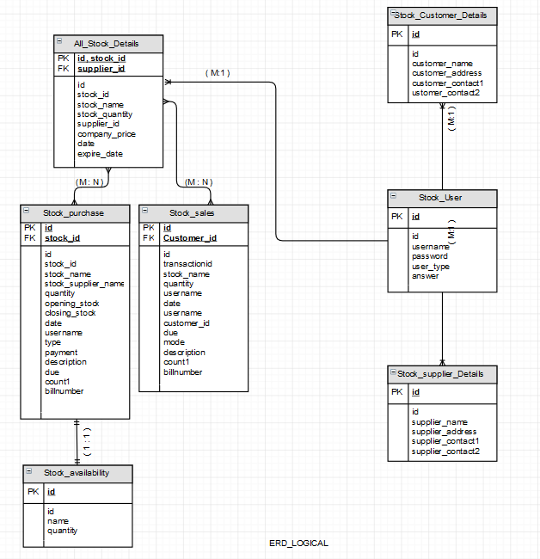
ERD

Slide 15
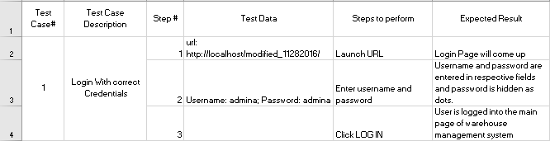
Test Case
LOGIN

Slide 16
SCREENSHOTS

Slide 17
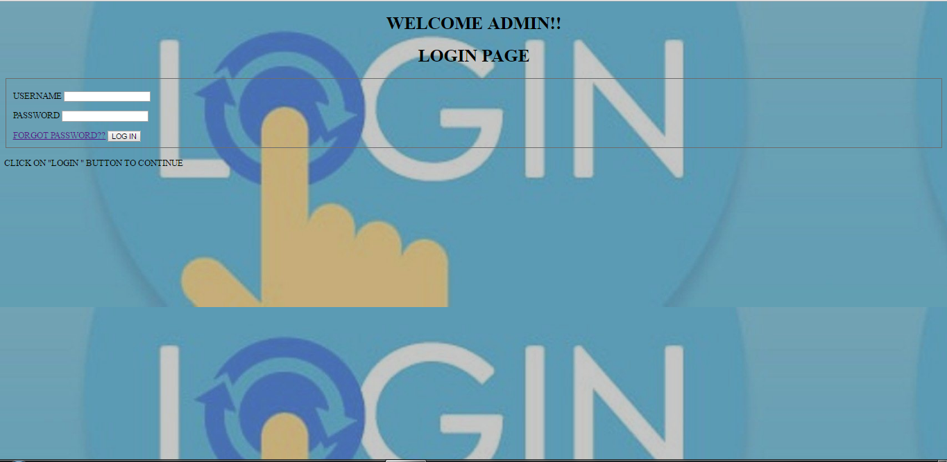

Slide 18
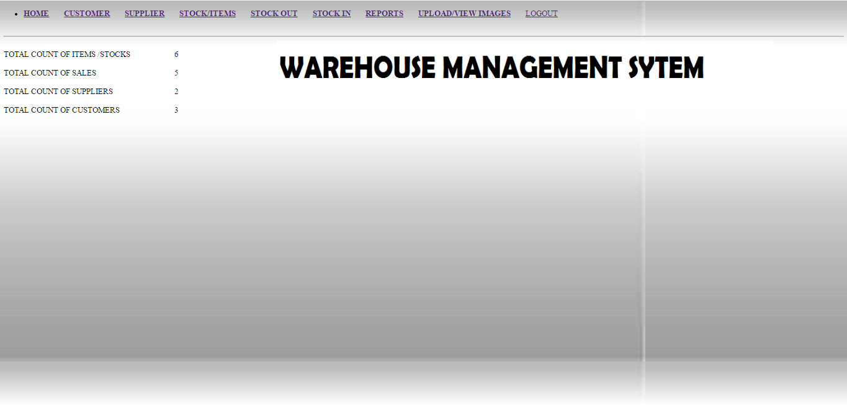

Slide 19
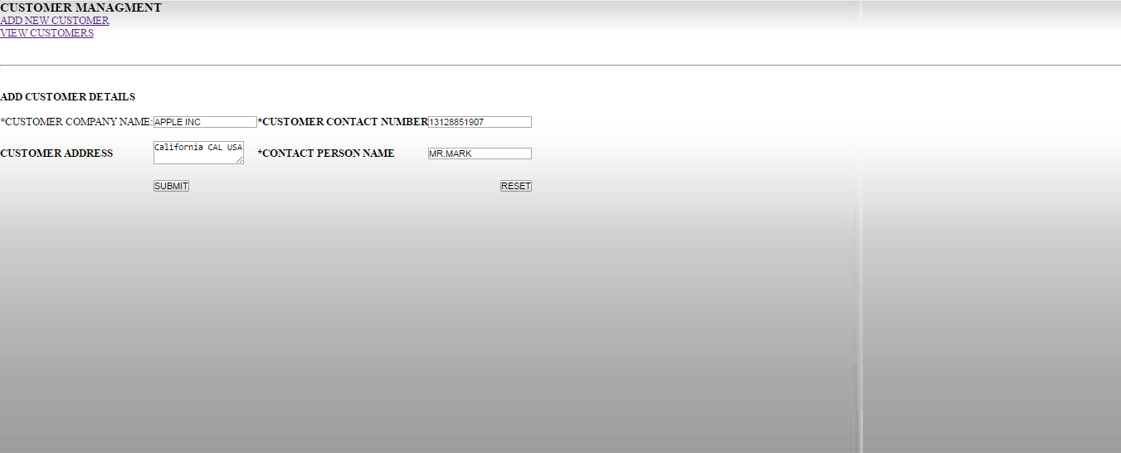

Slide 20
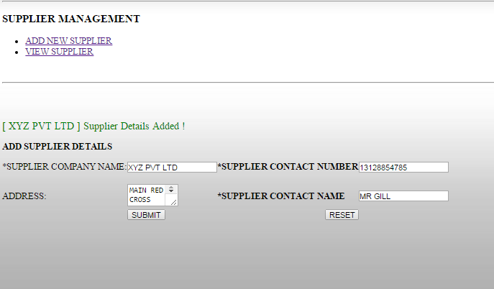

Slide 21
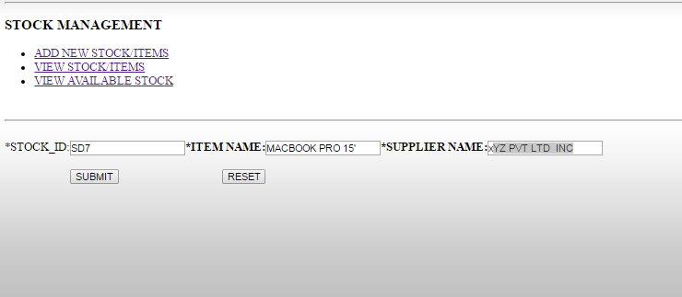

Slide 22
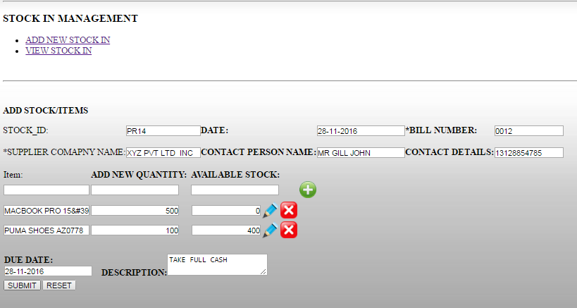

Slide 23
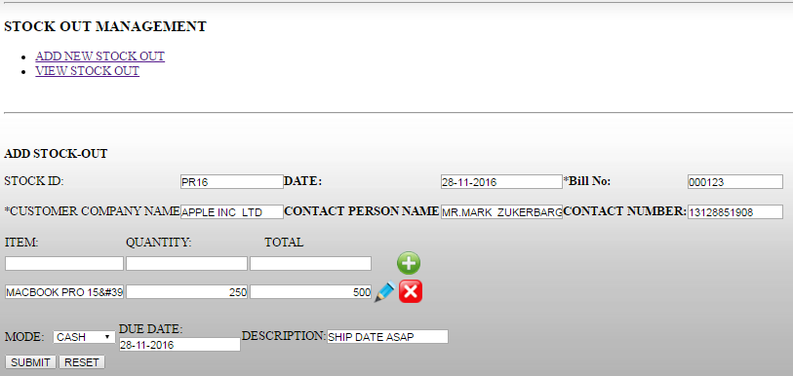

Slide 24
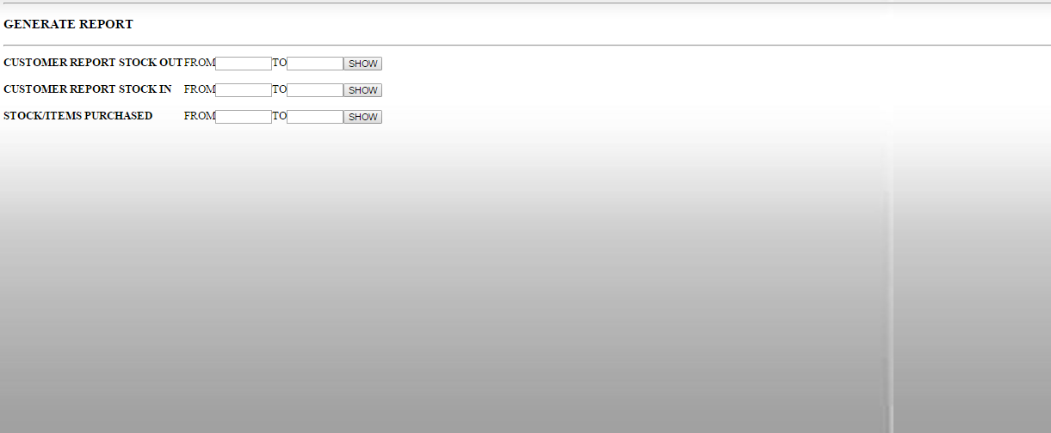

Slide 25
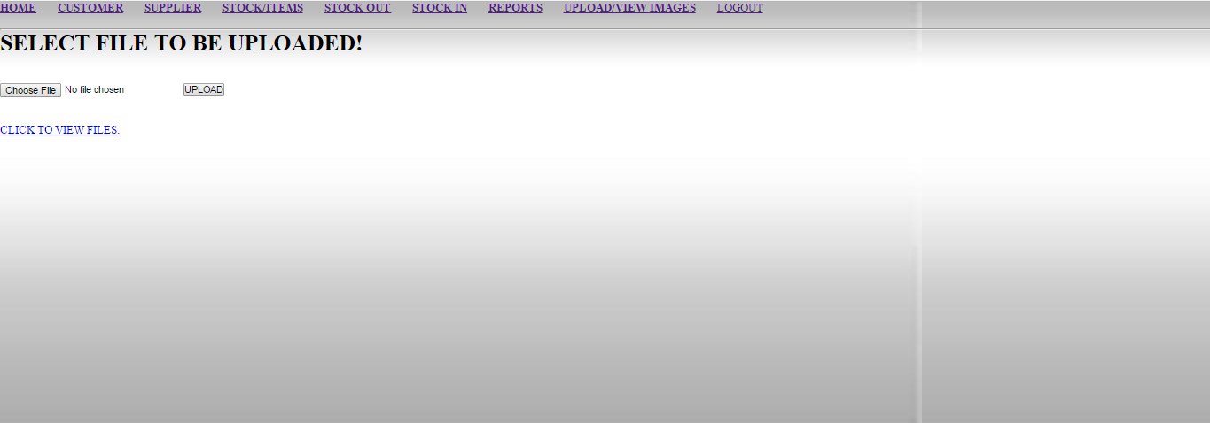

Slide 26
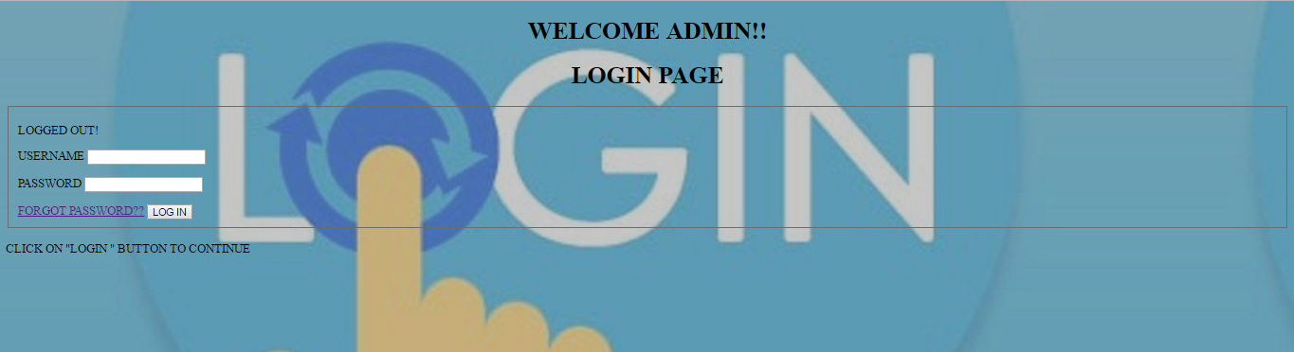

Slide 27

WORKING

Slide 28
Future Scope
CAPTCHA
DISTRIBUTED DATABASE DESIGN(multiple data entry at same time)
RESET PASSWORD VIA EMAIL
MOBILE APPLICATION
CATEGORIZATION
HONEYPOT
CORELATION ANALYSIS(like Amazon)
FEEDBACK
SQL Injection

Slide 29
THANK YOU

Slide 30

ANY QUESTIONS??

